Slide 1
8.Pointers

Slide 2
Mrs. kvb
Sr. Lecturer, Information Technology,
SBMP

Slide 3
Learning Outcomes
Students will be able to:
Modify variable value using name and address
Define pointer with an example.
Demonstrate Call-By-reference using pointer

Slide 4
Value and Address of a variable

Slide 5
Variable Value and Address
Every variable in C++ has three mandatory parts name, value and address.
A variable is known with its name in the program as far as its’ scope and lifetime is persists.
int x=5;
x
name
5
value
2048
address

Slide 6
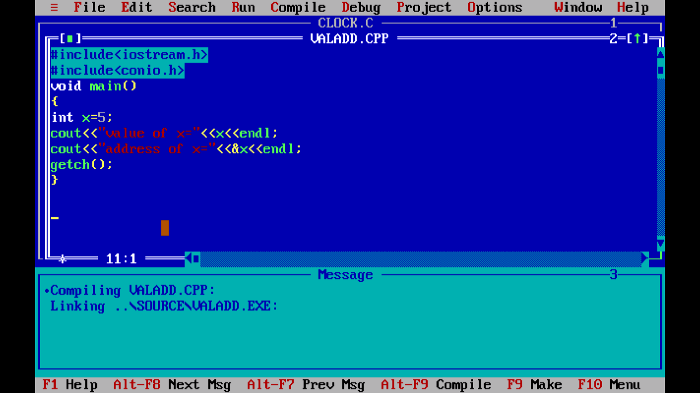
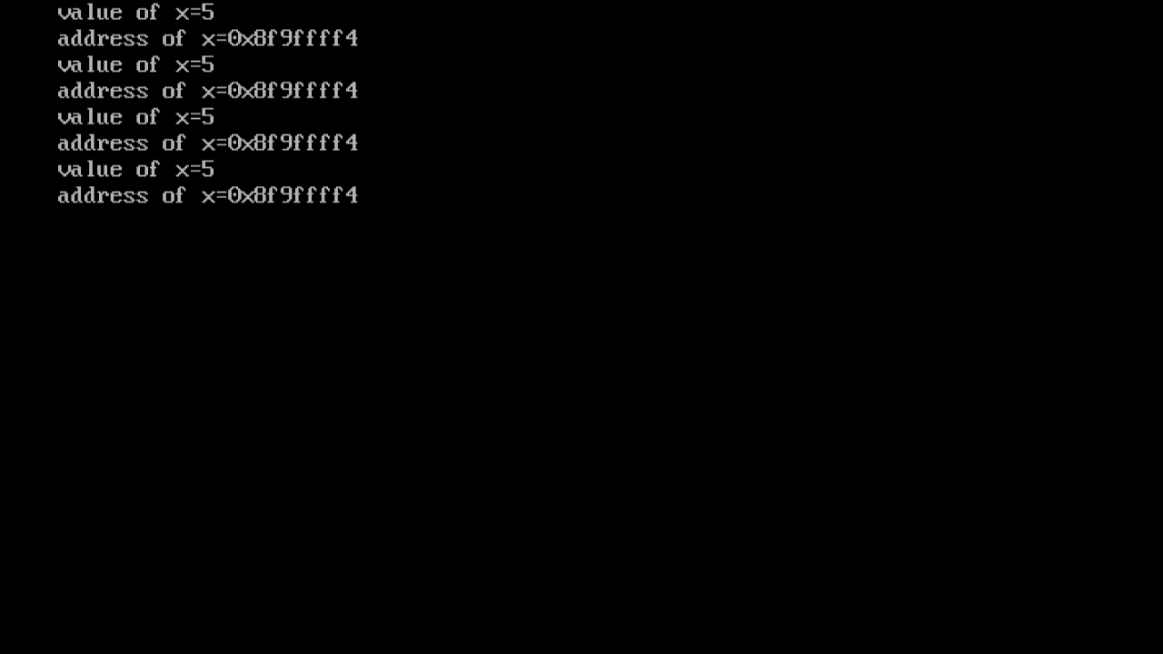
Variable Value and Address
Displaying value and address of a variable (turboc/c++).
Address of a variable = & var_name;
Output

Slide 7
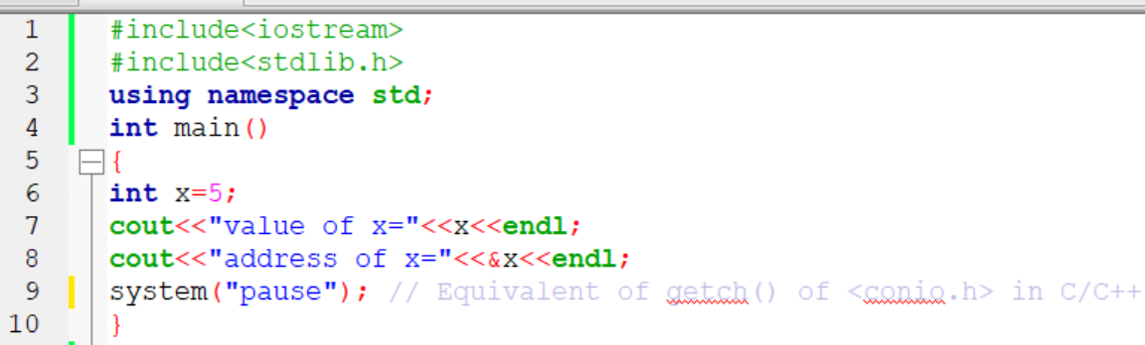
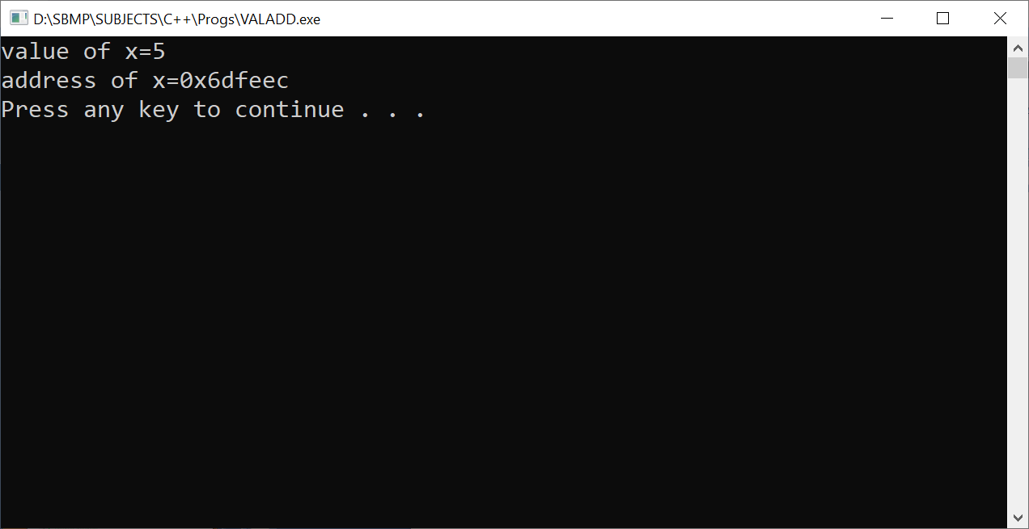
Variable Value and Address
Displaying value and address of a variable (CodeBlocks).
Output
system(“cls”);

Slide 8
Here, address of a variable is displayed in hexadecimal form
0x = hexadecimal
To get decimal number:
i.e. 0x8f9ffff4 = 2,409,627,636 on 8GB RAM (Decimal addresses from 0 to 8,589,934,591)
i.e. 0x6dfeec = 7,208,684‬ on 8GB RAM
Total addresses = 2³³( 8GB = 2³x2³⁰ = 2³³)

Slide 9
Total addresses for 8GB RAM = 2³³( 2³x2³⁰ = 2³³)
Total addresses for 4GB RAM = 2³²( 2²x2³⁰ = 2³²)
Note: In exam we can consider addresses in decimal number i.e. 1020, 2024, 4028, etc.

Slide 10
Changing value of a variable
Value of a variable = *(&var_name)
int x=5; // x = x+2;
// modifying the value of x
*(&x) = *(&x) + 2; // x=x+2;
cout<<“x=”<<x; // x=7
Note: *(&x) = x

Slide 11
Pointer
A pointer is a variable which stores address of another variable of the same type.
Syntax: data_type *ptr_var;
Example: int *ptr;
As it is a variable, it also has name, value and address fields.
As The value of pointer is a RAM address, it is an unsigned number (not negative)
The default value of a pointer is garbage.
To know the address = &ptr

Slide 12
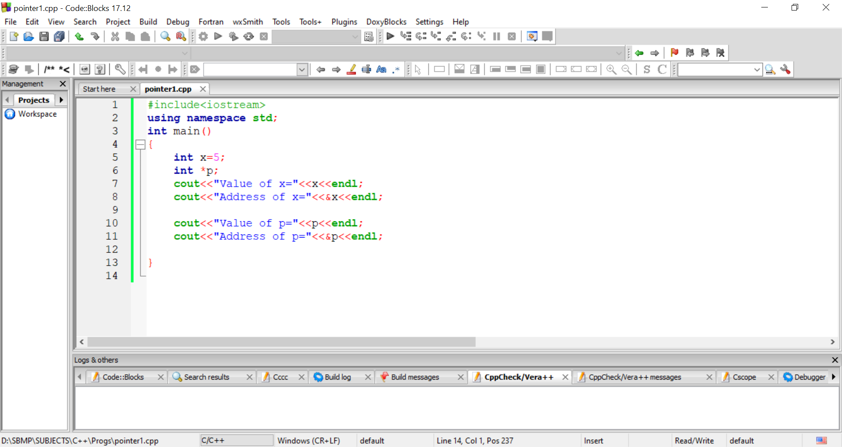
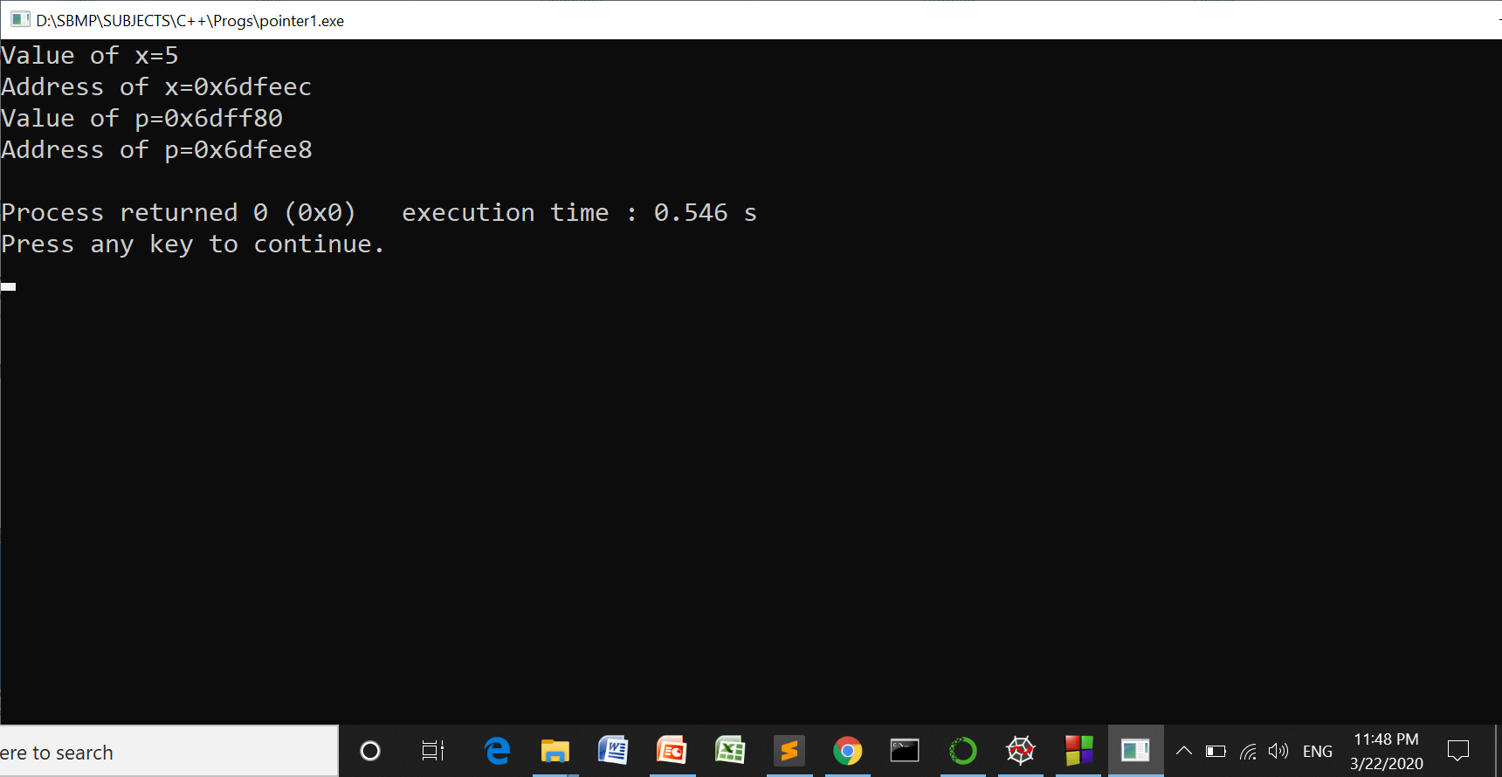
Pointer

Slide 13
Changing value of a variable using a Pointer
A pointer can be assigned the address of another variable
p = &x;
Now, we can change the value of x using pointer as follows:
*p = *p +2;
Can be simplified as:
*(&x) = *(&x) + 2 // putting p=&x;
x = x + 2

Slide 14
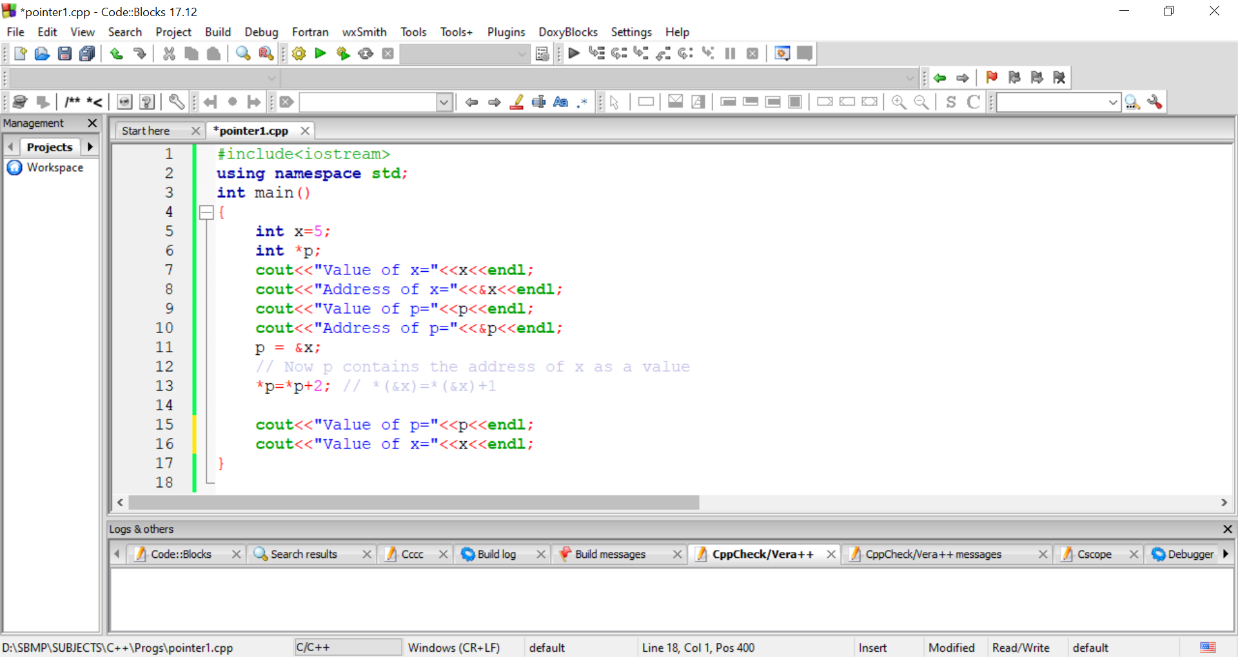
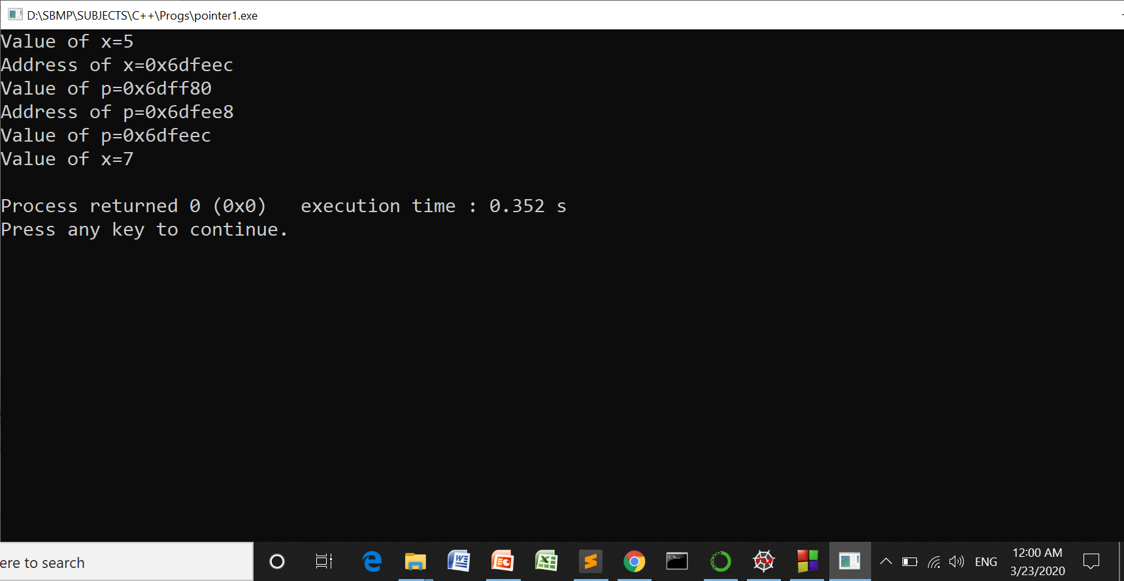
Changing value of a variable using a Pointer

Slide 15
Exercise

Slide 16
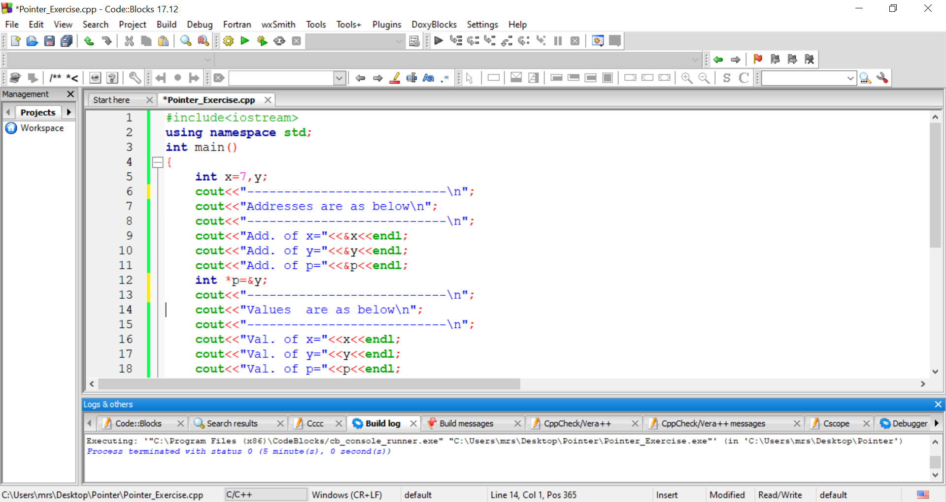
Predict the output of the program
int *p;

Slide 17
Predict the output of the program
x
y
p
7
0x6dfeec
0x6dfee8
0x6dfee4

Slide 18
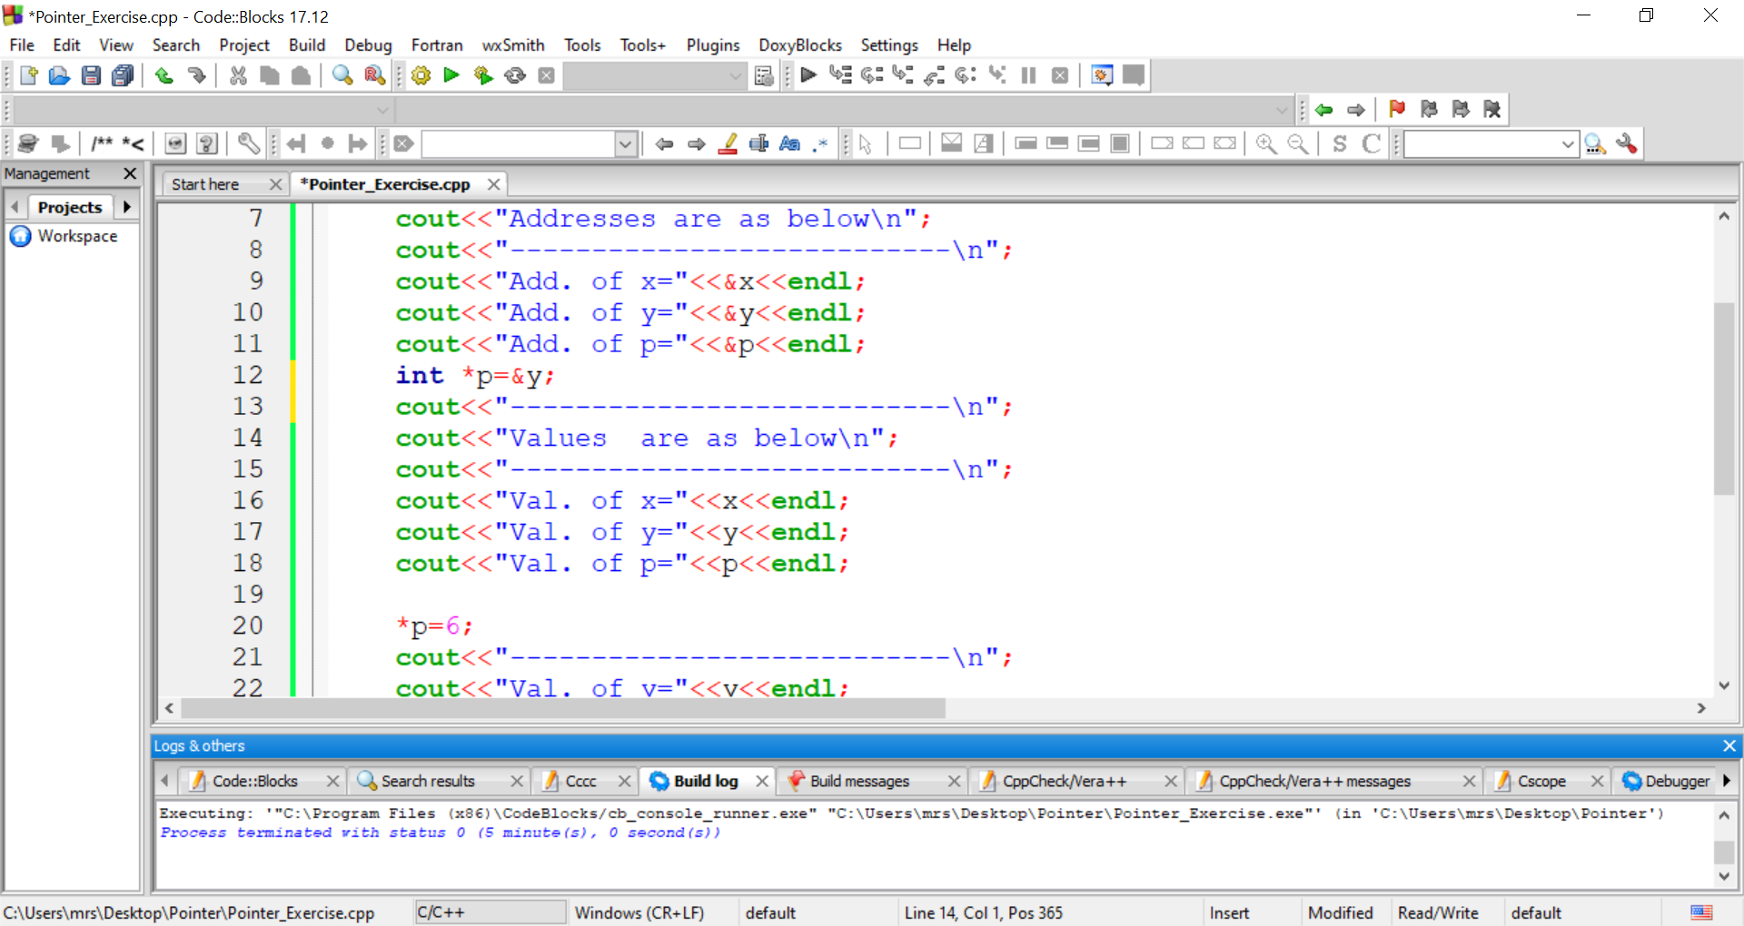
Predict the output of the program

Slide 19
Predict the output of the program
x
y
p
7
223045
0x6dfee8
0x6dfeec
0x6dfee8
0x6dfee4
In turboc 2bytes -32768 to +32767
Code Blocks 4 bytes

Slide 20
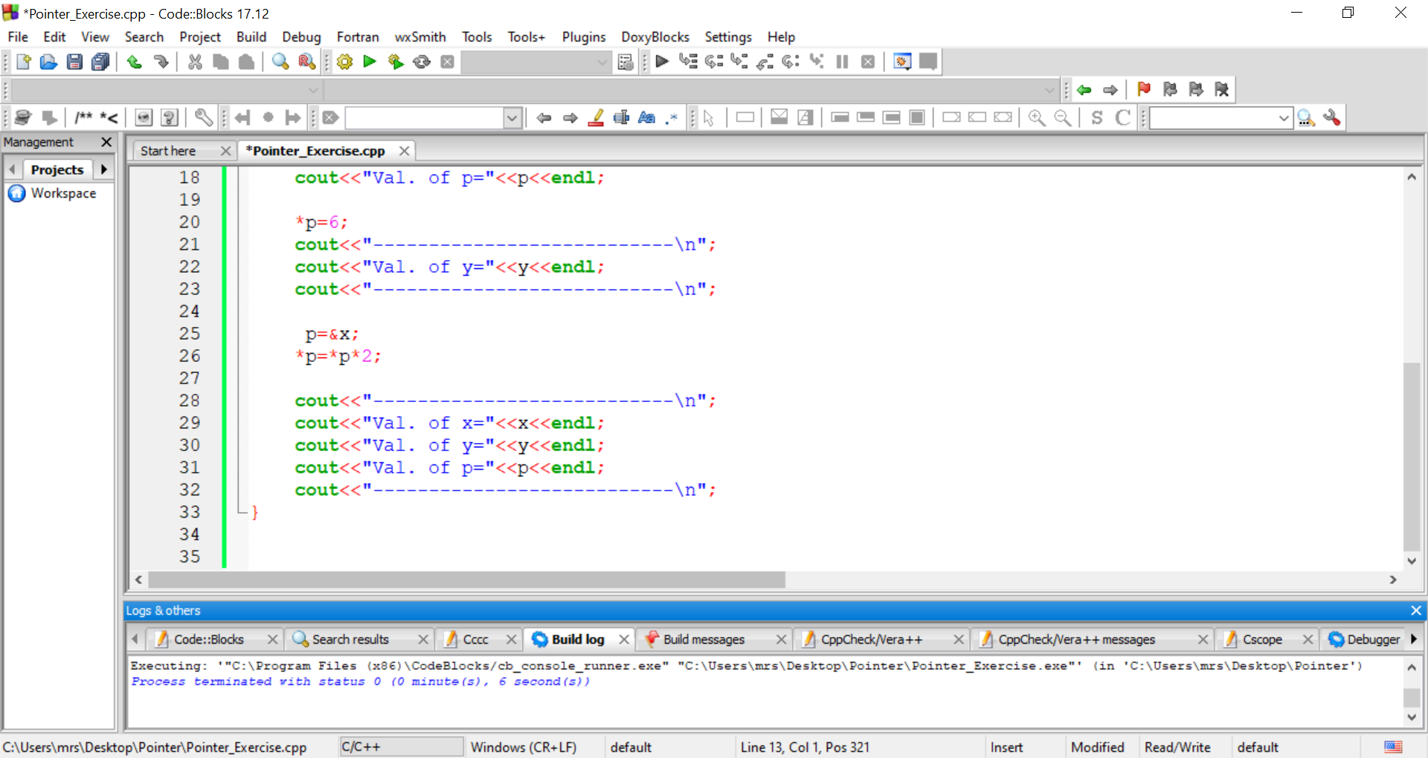
Predict the output of the program
x
y
p
7
6
0x6dfee8
0x6dfeec
0x6dfee8
0x6dfee4

Slide 21
Predict the output of the program

Slide 22
Predict the output of the program
x
y
p
14
6
0x6dfeec
0x6dfeec
0x6dfee8
0x6dfee4

Slide 23
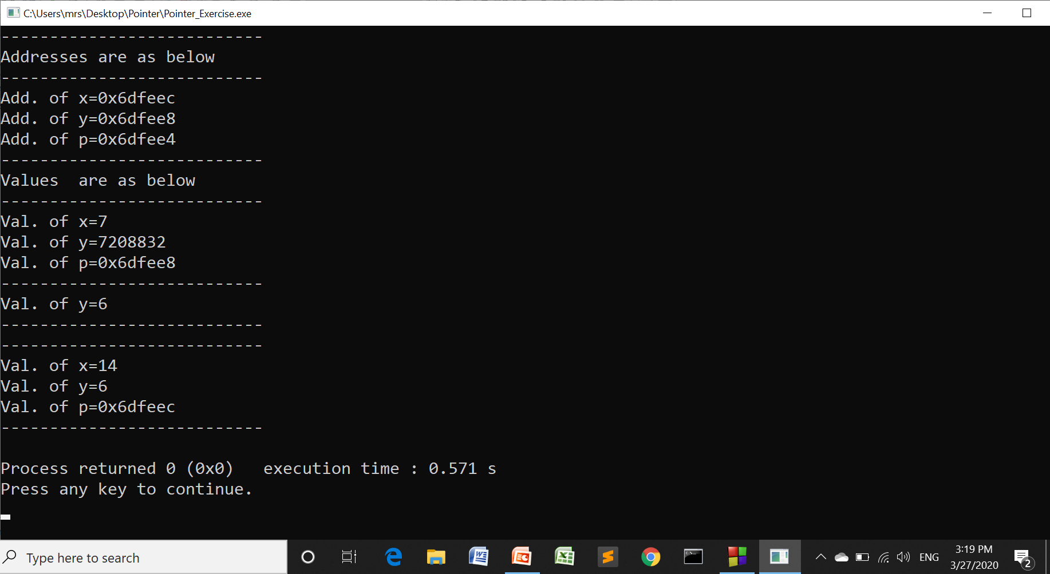
Predict the output of the program

Slide 24
A variable can be accessible out side the scope using a pointer.
A function can Return multiple values using a pointer.
call-by-reference or pass-by-reference

Slide 25
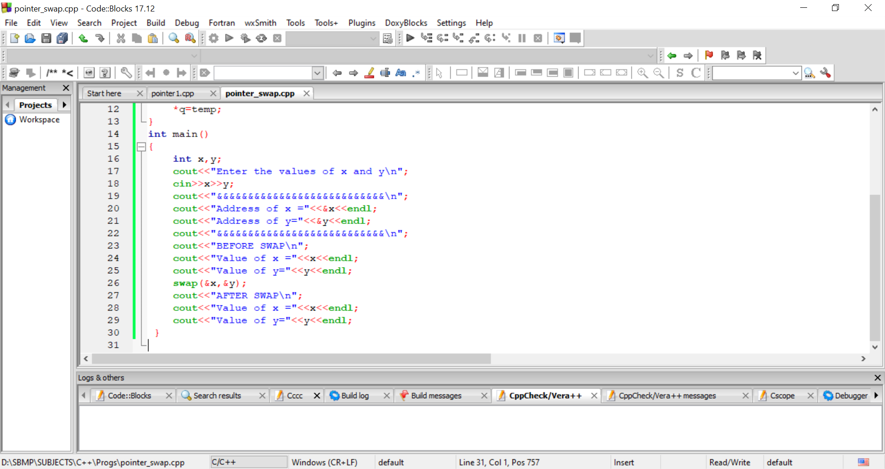
Pass-by-reference
We can write swapping number program using pointers.

Slide 26
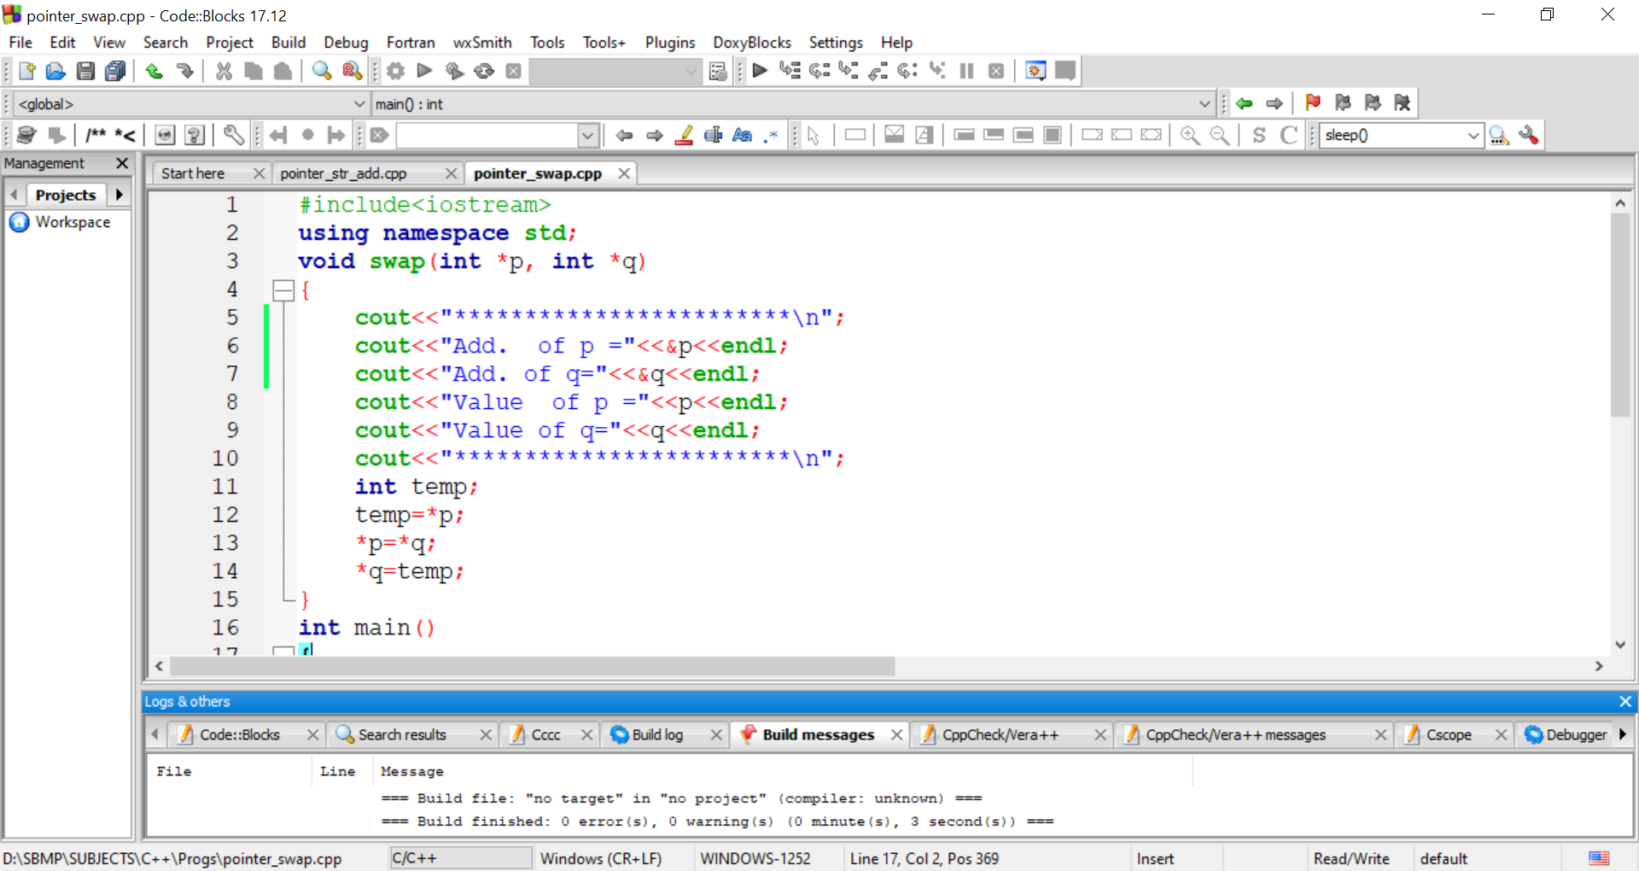
Pass-by-reference
The address of x and y are passed to pointers p and q respectively.
*(0x6dfeec) = x
X=y;
Y=temp

Slide 27
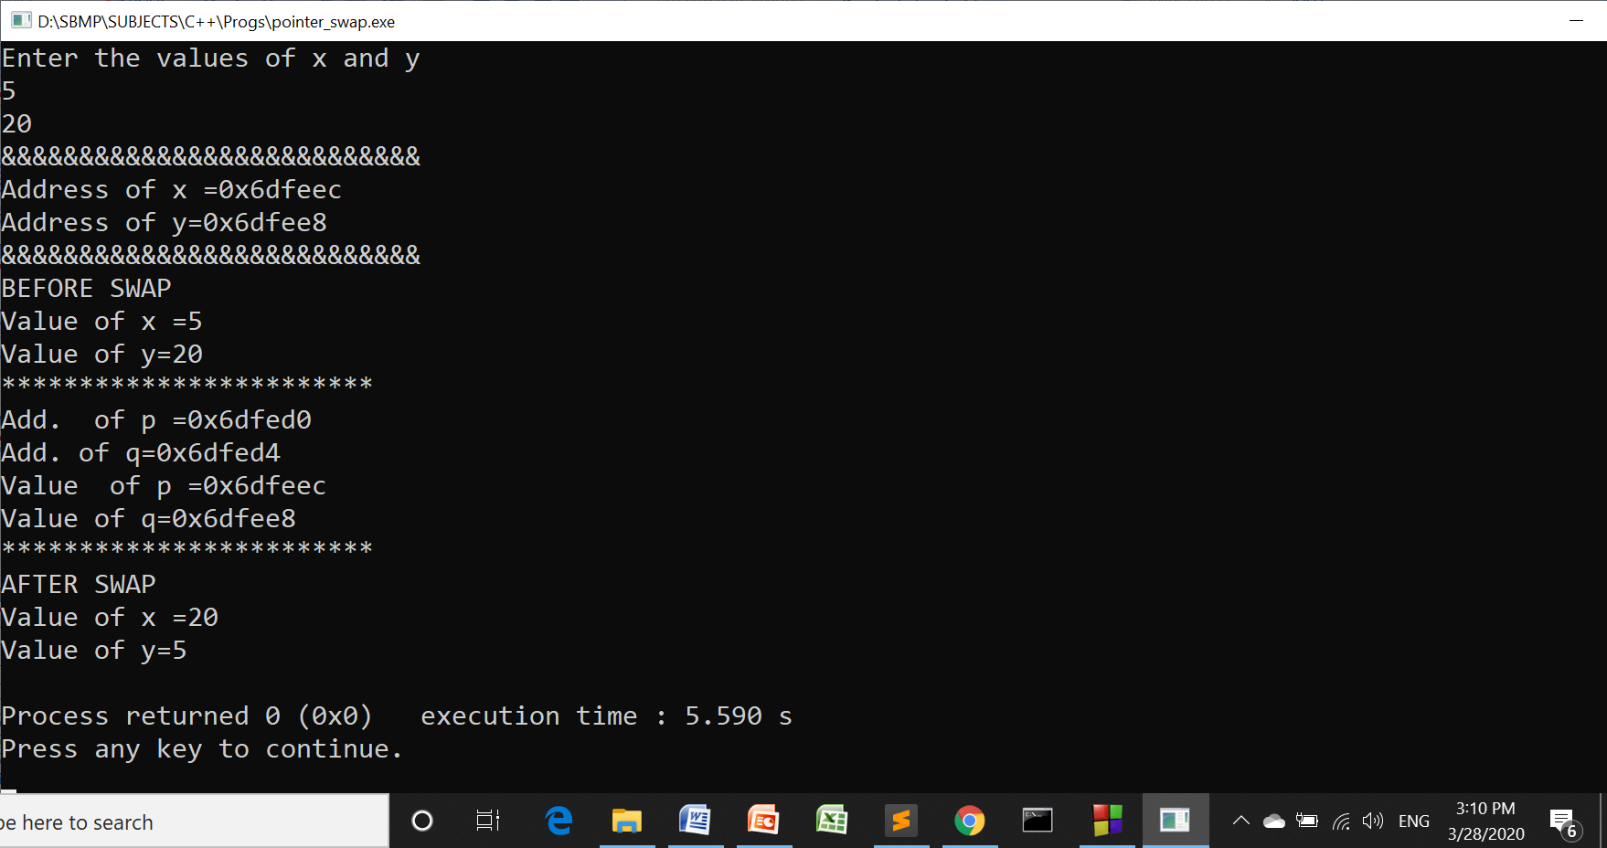
Pass-by-reference
Observe the value of p and q. They are addresses of x and y respectively.

Slide 28
Pass-by-reference
main()
x
y
5
20
0x6dfeec
0x6dfee8
q
swap()
p
0x6dfeec
0x6dfee8
0x6dfed0
0x6dfed4

Slide 29
Pointer Expressions
We can perform arithmetic + and – operators on pointers.
int x=5;
int *p=&x;
cout<<p; // 0xdfee8
p=p+1;
cout<<p; //0xdfeec 0xdfeea
As int takes 4 bytes, p will be incremented by 4.
Note: In turboC/C++ , int takes 2 bytes.
Arithmetic operators * and / can not be applied on the pointers.

Slide 30
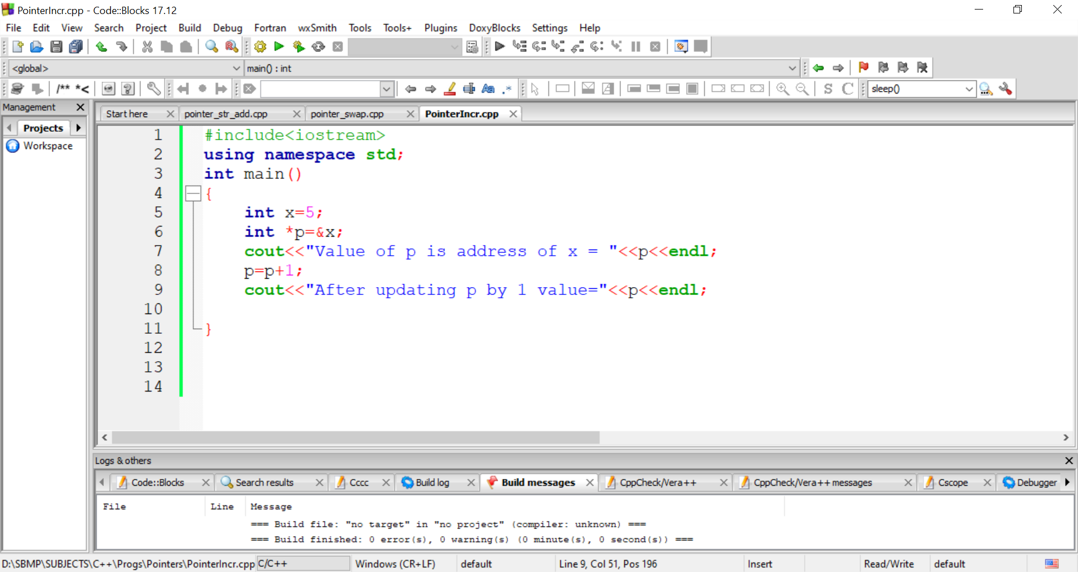
Pointer Expressions

Slide 31
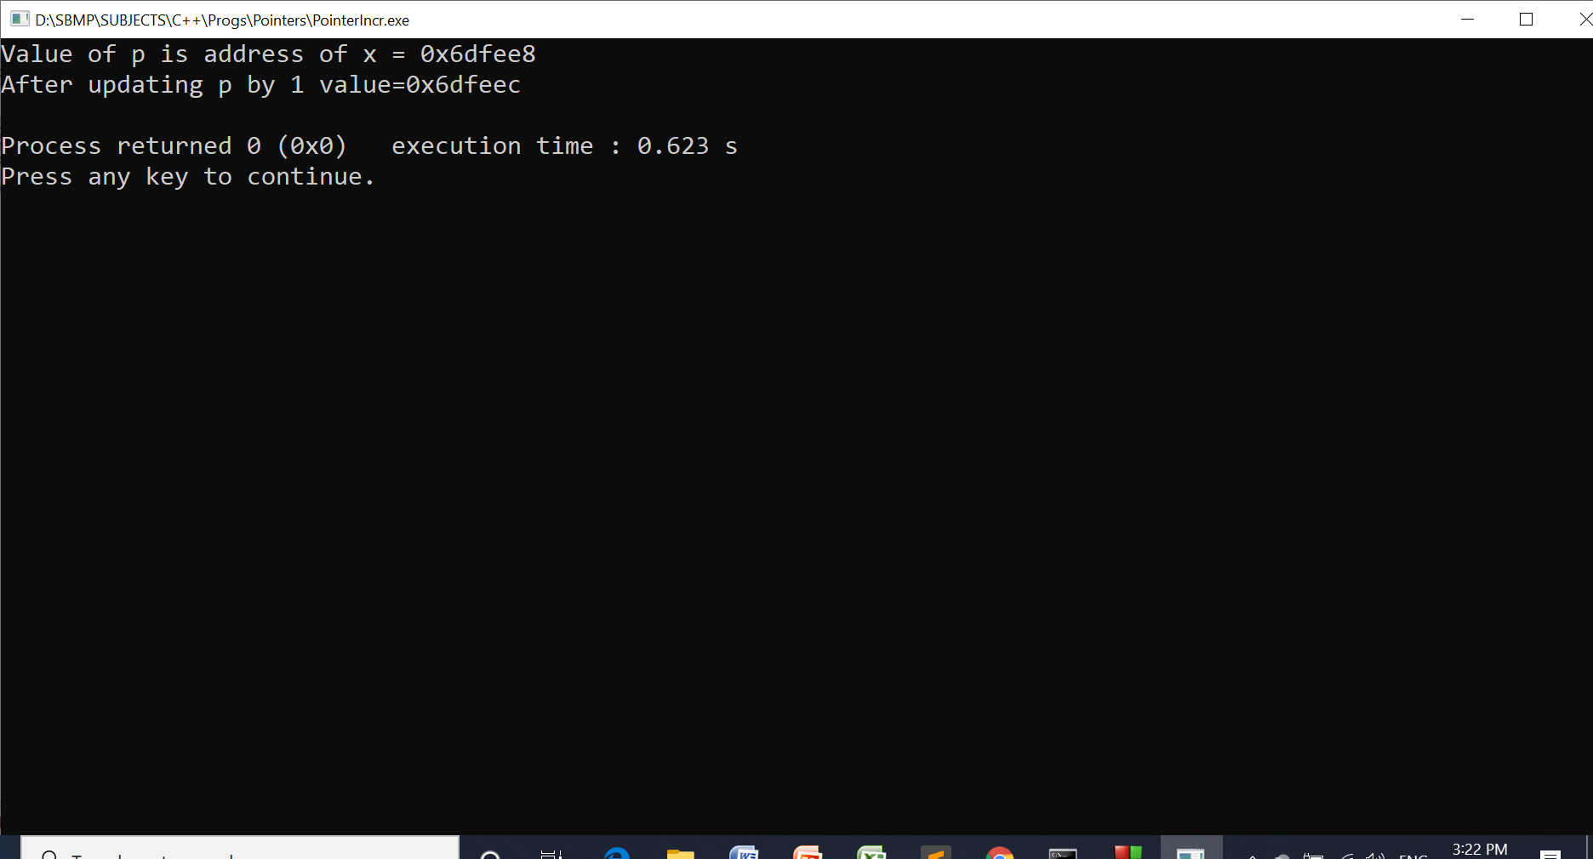
Pointer Expressions

Slide 32
Pointer to an array
As array is allocated memory locations contiguously (sequentially), If we know the address of first array element, we can traverse the entire array by incrementing the address.
A pointer can be assigned the address of the first location of an array as follows:
int a[10];
int *p = &a[0];
Note: &a[0] = a

Slide 33
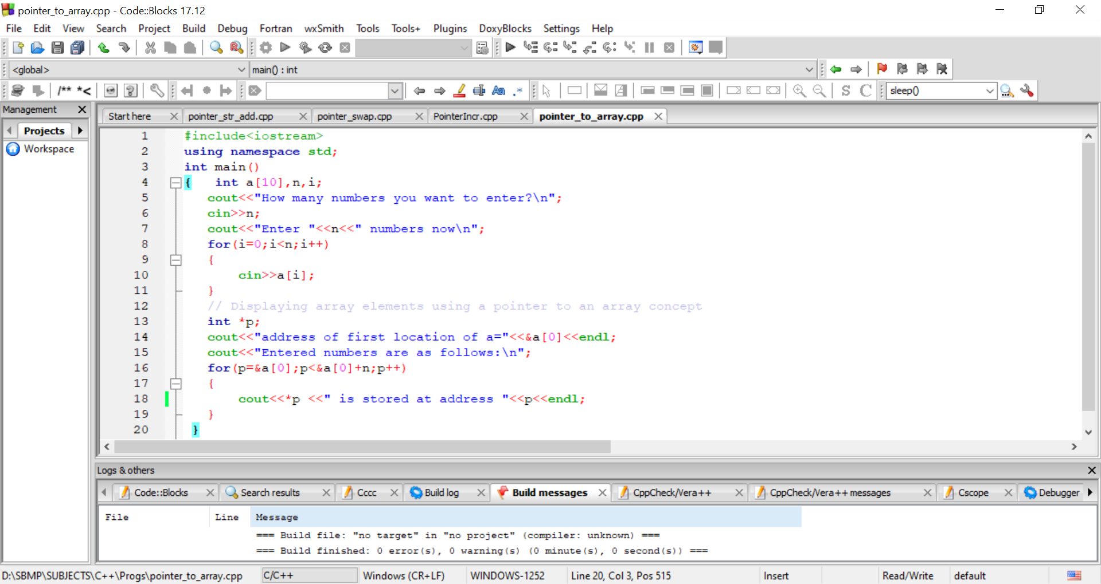
Pointer to an array
*p = *(&a[0]) =

Slide 34
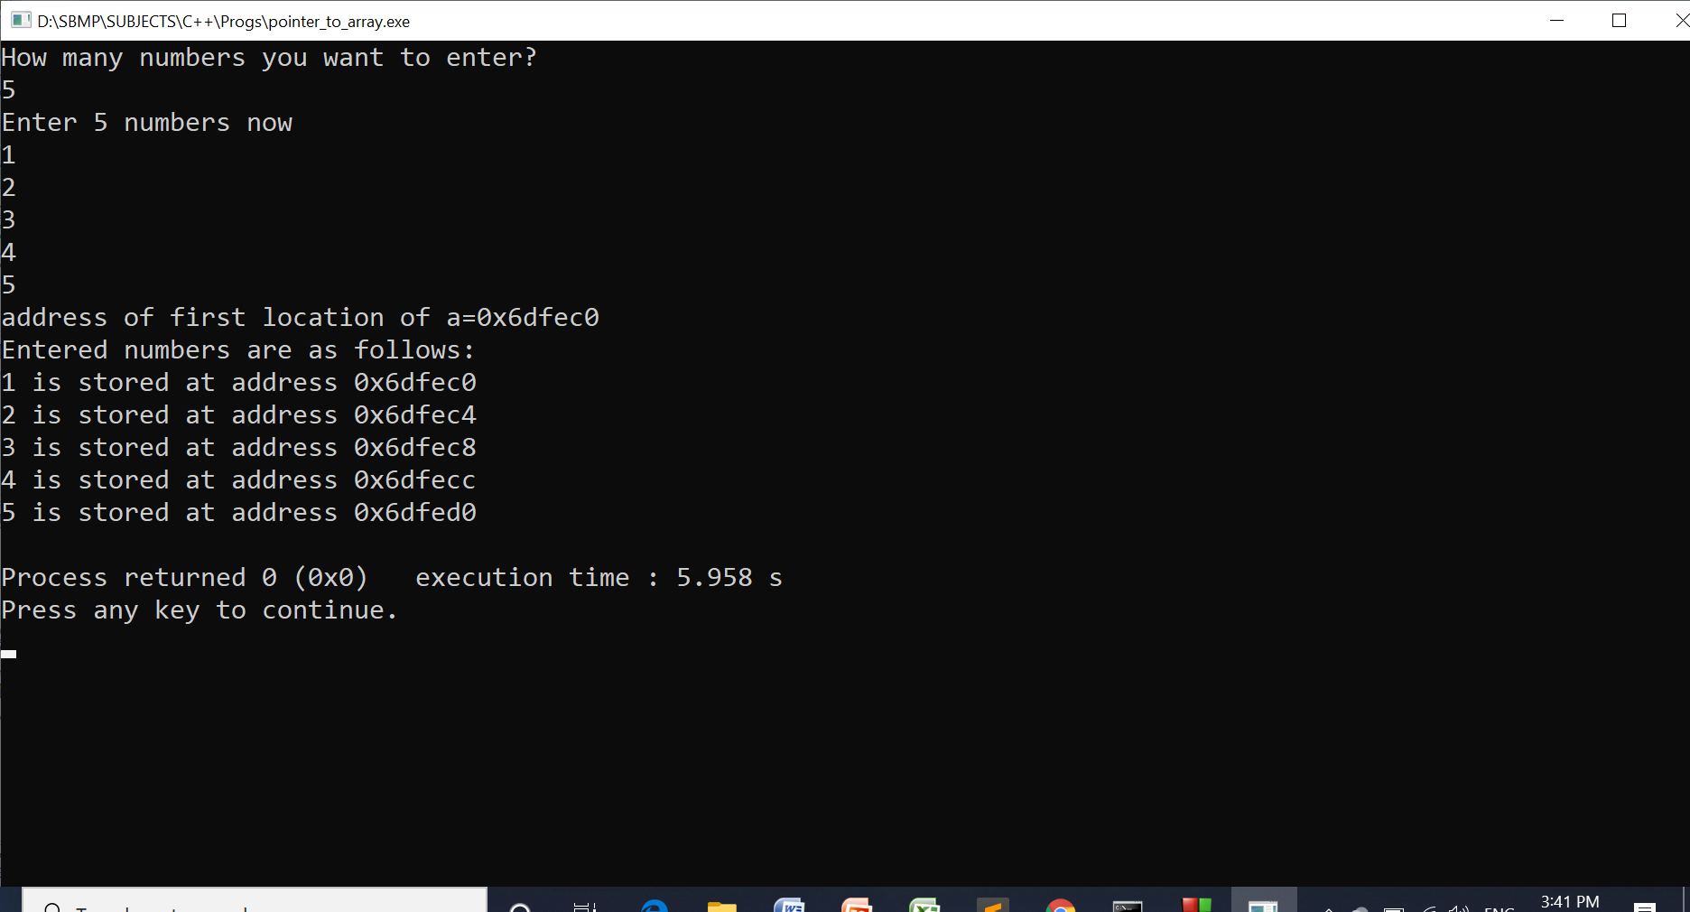
Pointer to an array
Here, address 0x6dfec0 will be copied to p at first. As p is incremented by 1 , it will become 0x6dfec2 then 0x6dfec4, and so on.
for loop termination condition =p< &a[0]+n
=p< 0x6dfec0+(5)
=p<0x6dfed4 // +5 means 5*4 =20
// 20 in hex =14H Therfore 0x6dfec0+0x14 = 0x6dfed4

Slide 35
A string pointer
A string pointer can be declared as below:
char *sptr;
Assigning address of string to string pointer
char str[15];
cout<<“Enter the string\n”;
cin>>str;
char *sptr=&str[0]; //Assigning the address of first char
// char *sptr=str;
To know the address of first character: (void *)sptr
cout<<“Address of first character=”<<(void *) sptr;
To know the character stored at first address: *sptr
cout<<“Character stored at first address=”<<*sptr;

Slide 36
In case of string pointer i.e. sptr
cout<<sptr;
Will print content of entire string.

Slide 37
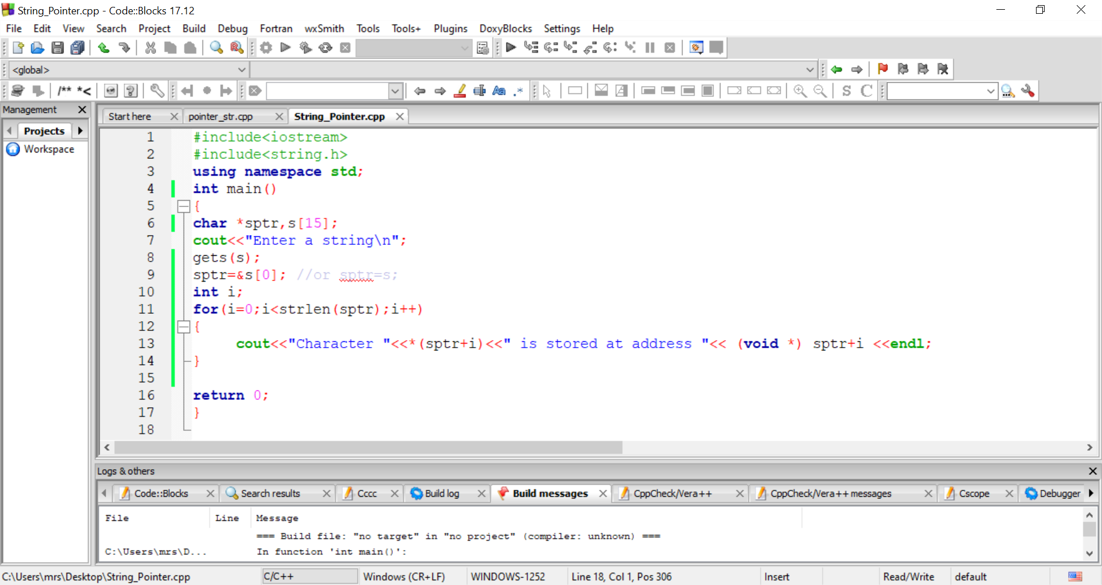
A string pointer
For(sptr=&s[0]; sptr<&s[0]+strlen(str);sptr++)

Slide 38
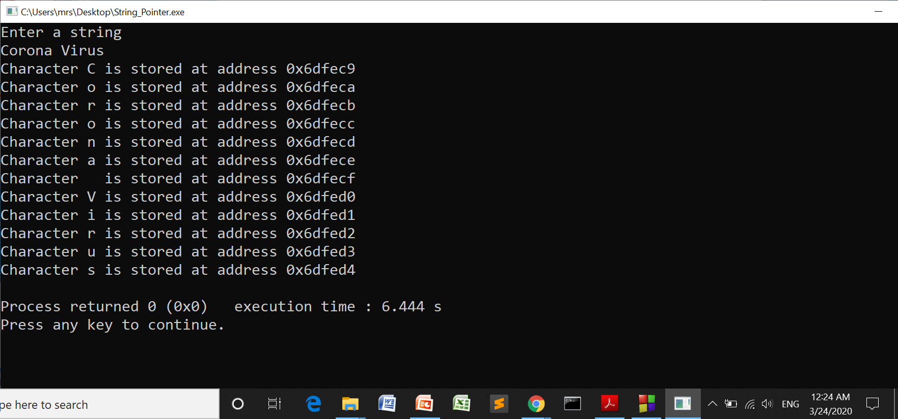
A string pointer

Slide 39
Array of pointers
Like other data types, we can also create an array of pointers.
In this case each element of an array (pointer) can point the data which can be a single variable or an array of data.
Example :- int *p[3]; // array of 3 integer pointers
char *ps[3] // array of 3 string pointers

Slide 40
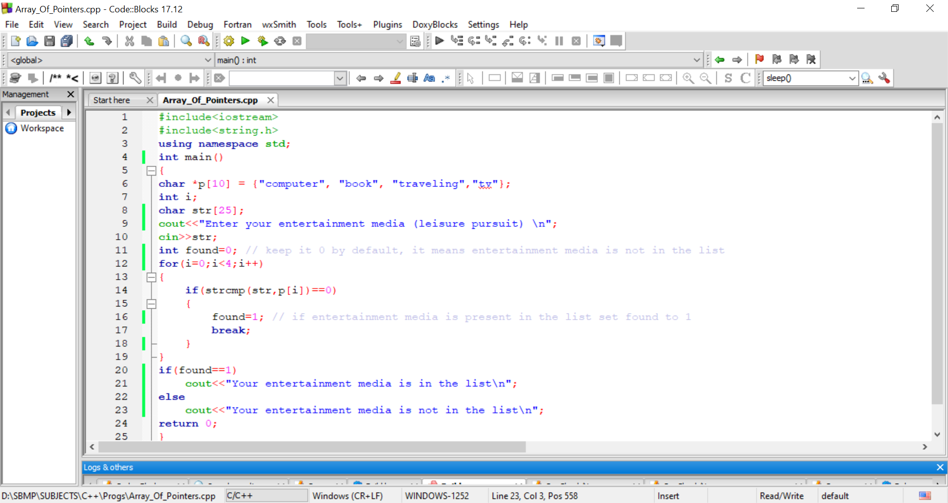
Array of pointers

Slide 41
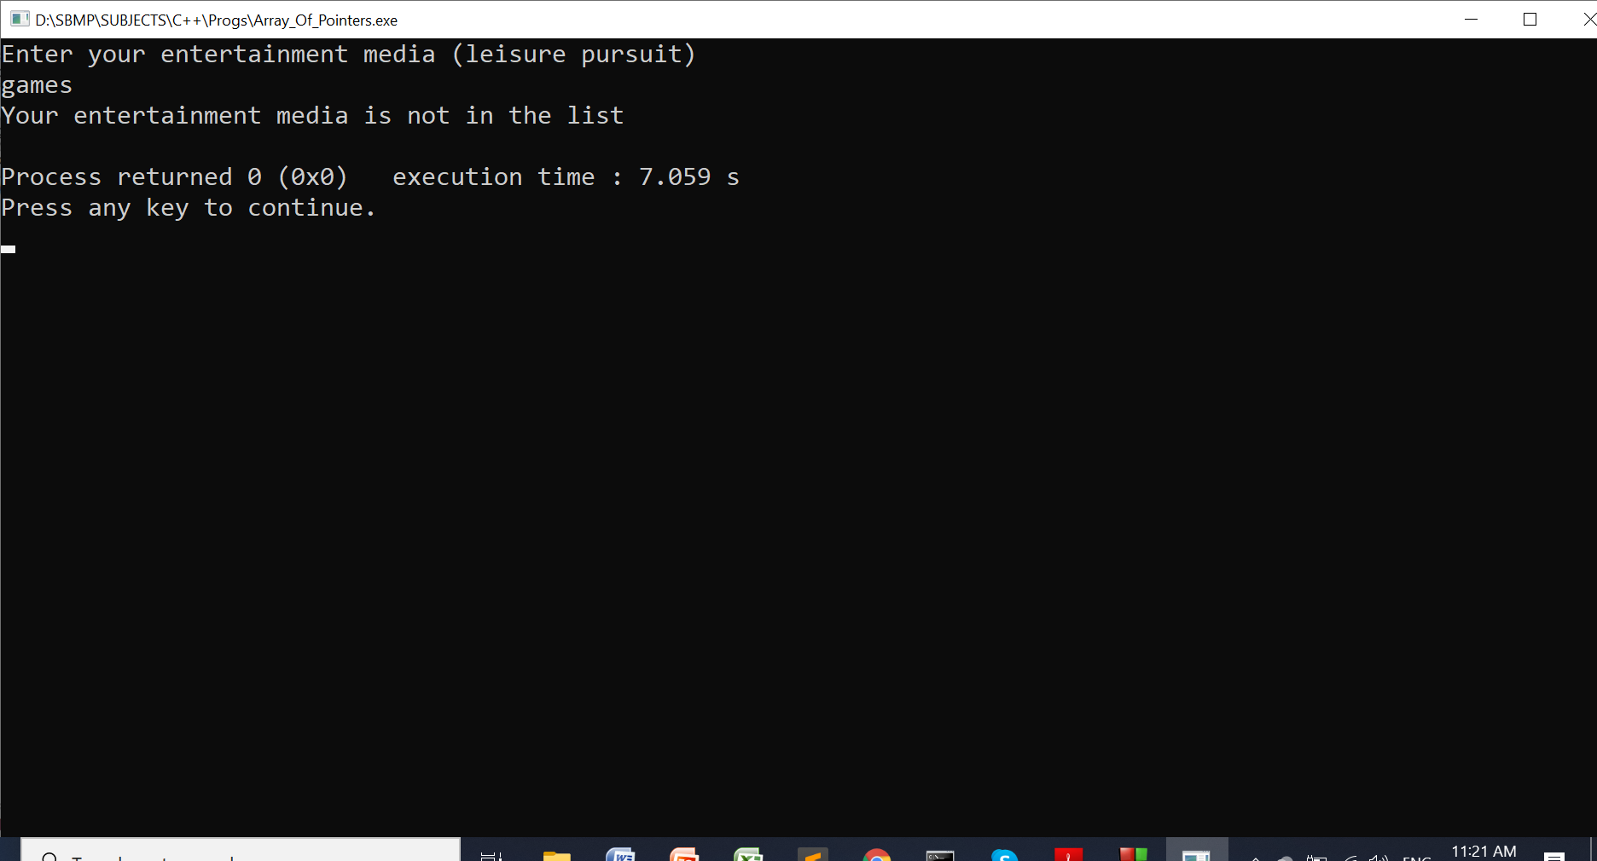
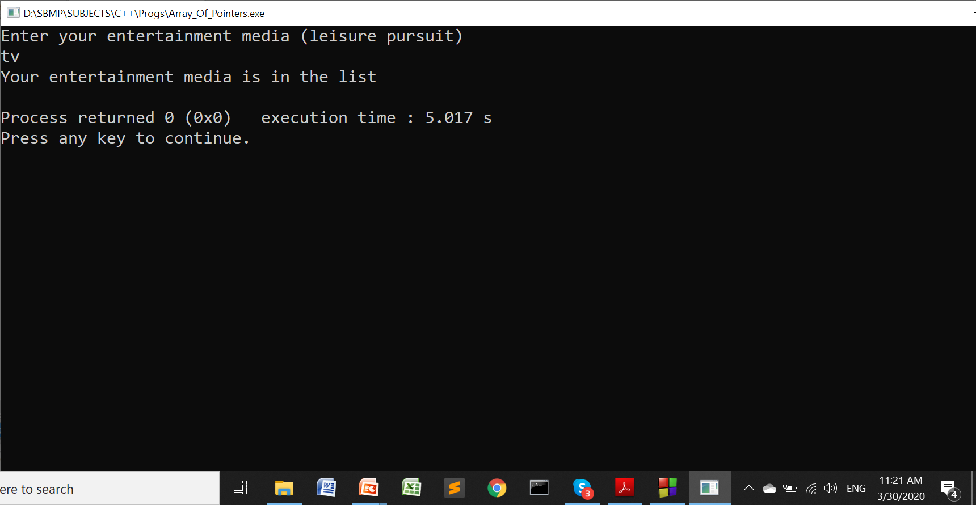
Array of pointers

Slide 42
Pointer to a function
Pointers to function concept is used for dynamic binding and for event based applications.
Also called as call back function. We can call the function dynamically at runtime.
Syntax: typedef data_type (*FunPtrName)(arg-list) ;
Example: typedef void (*FunPtr)(int, int) ;
Note: Here, FunPtr will become the data type for our pointer variable (shown in the program of next slide)

Slide 43
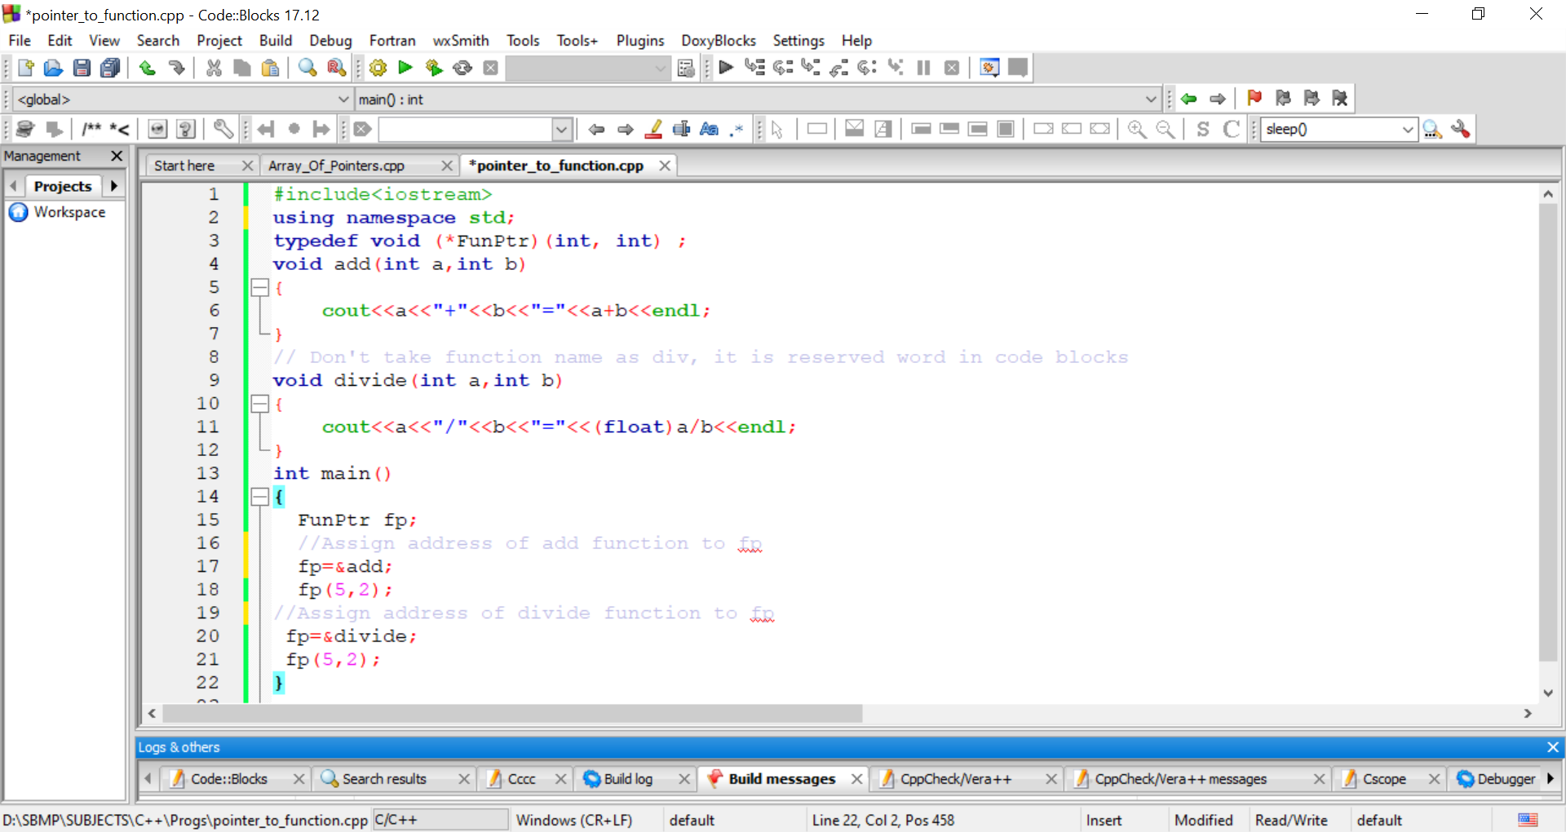
Pointer to Function

Slide 44
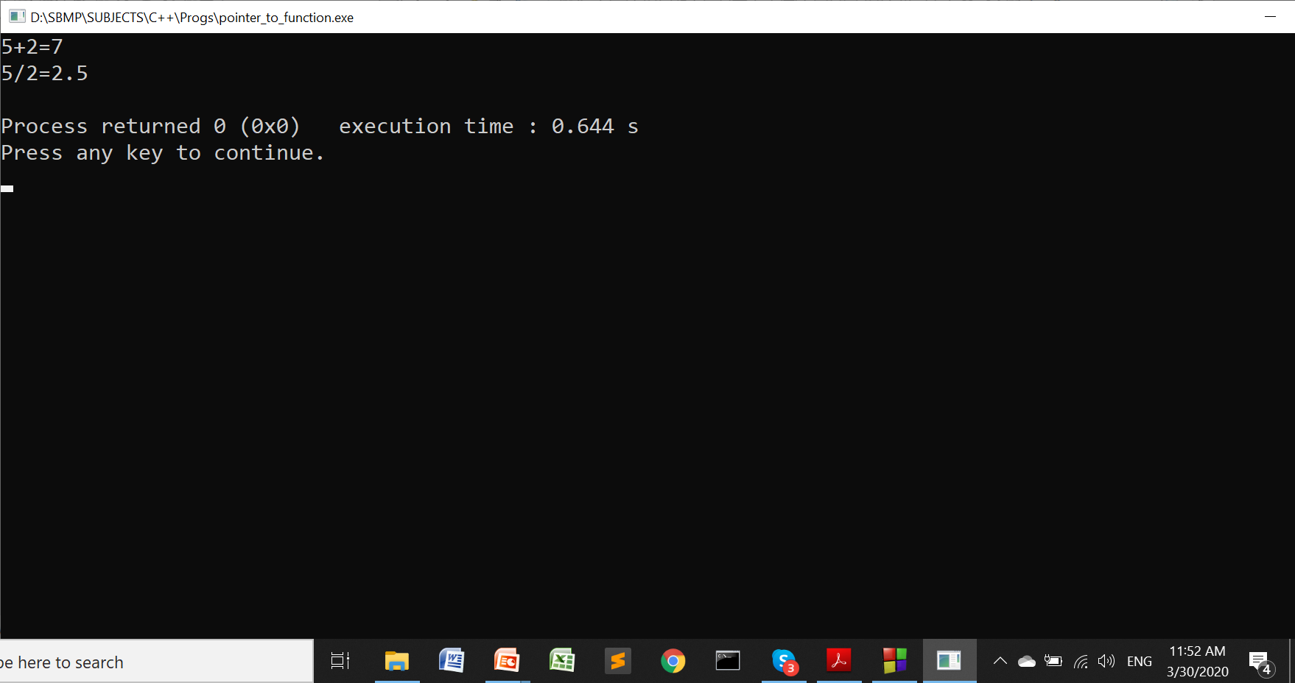
Pointer to Function

Slide 45
Thanks!
Any questions?
You can find me at:
manish_ratilal2002@yahoo.com

Slide 46
Credits
Object Oriented Programming with C++, E Balagurusamy, TMH

